Slide 1
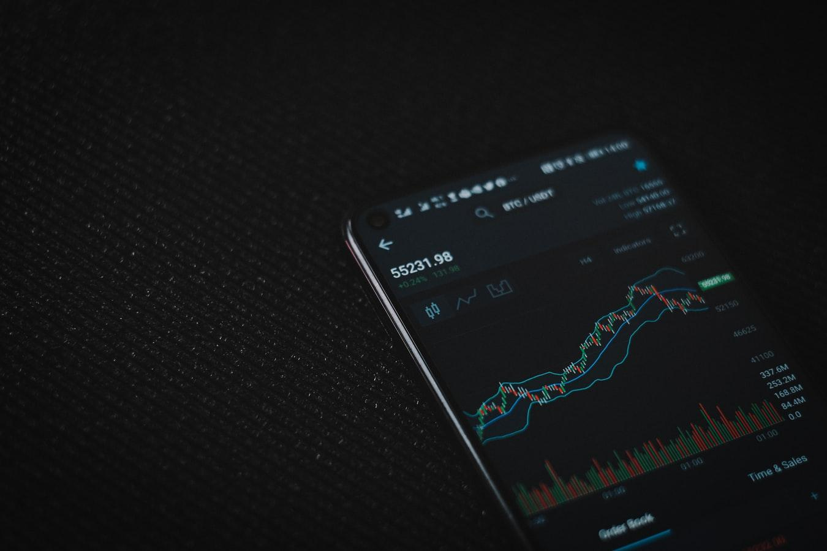
Forecasting and Predicting Bitcoin
Albin Wan

Slide 2
Table of Contents
Goals
Dataset
EDA
Models
Conclusion

Slide 3
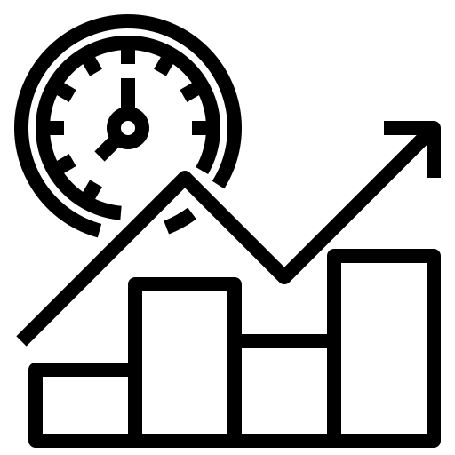


Goals
Forecast Future Price | Price prediction | Buy/Sell Signals

Slide 4
Efficient Market Hypothesis
Random Walk Theory

Slide 5


Dataset
Close Price | Volume | Hash Rate | Transaction Count | Unique Active Addresses | Google Trend Score

Slide 6
Exploratory Data Analysis

Slide 7
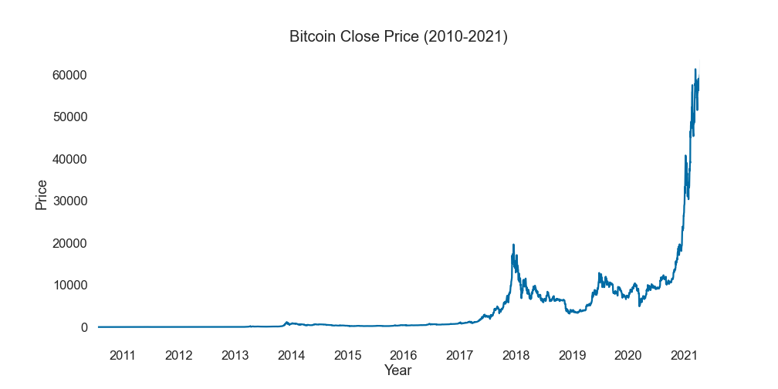

Slide 8
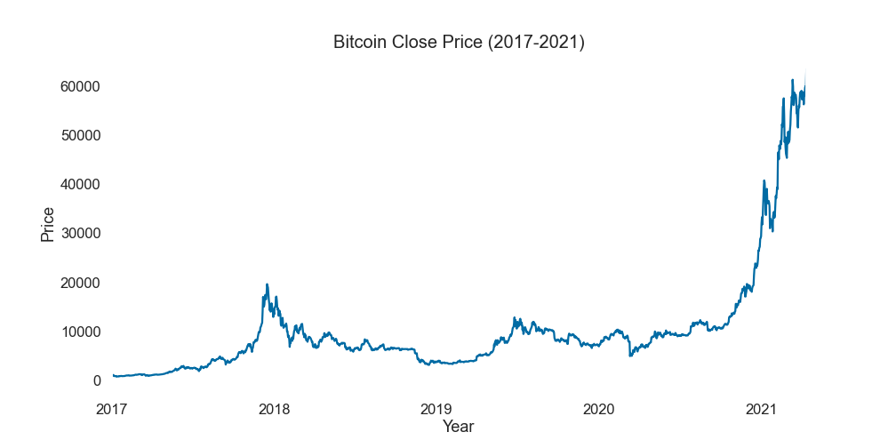

Slide 9
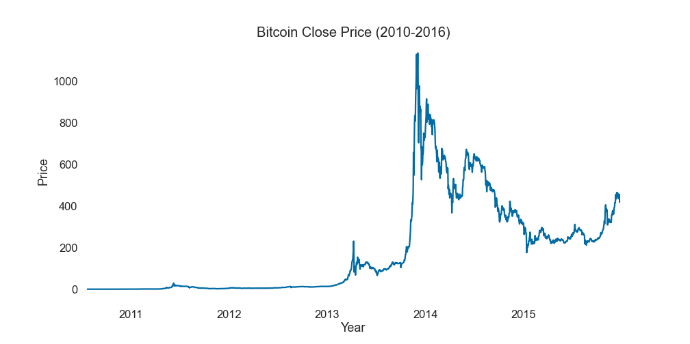

Slide 10
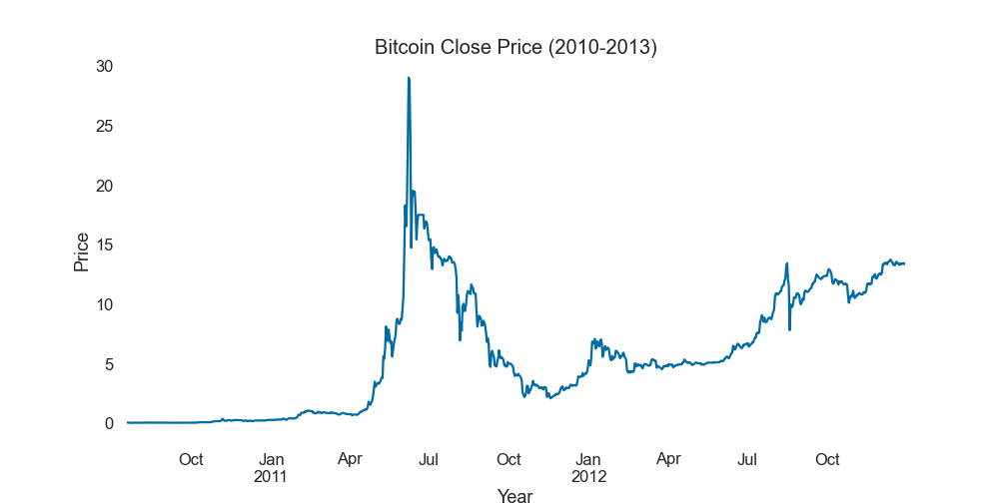

Slide 11
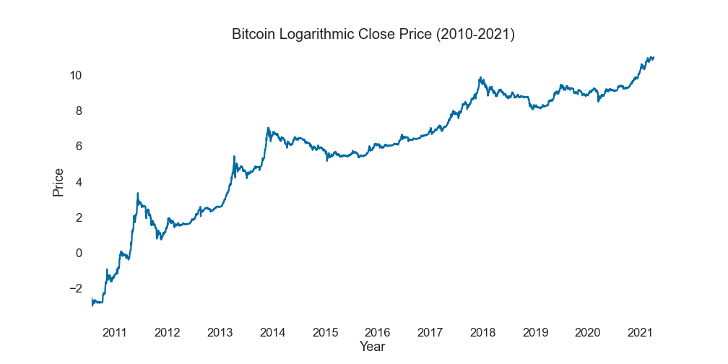

Slide 12
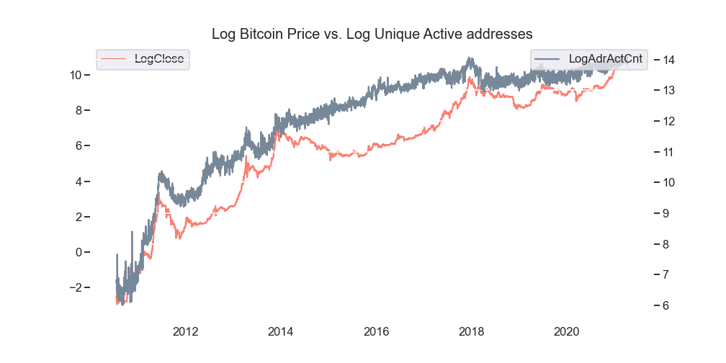

Slide 13
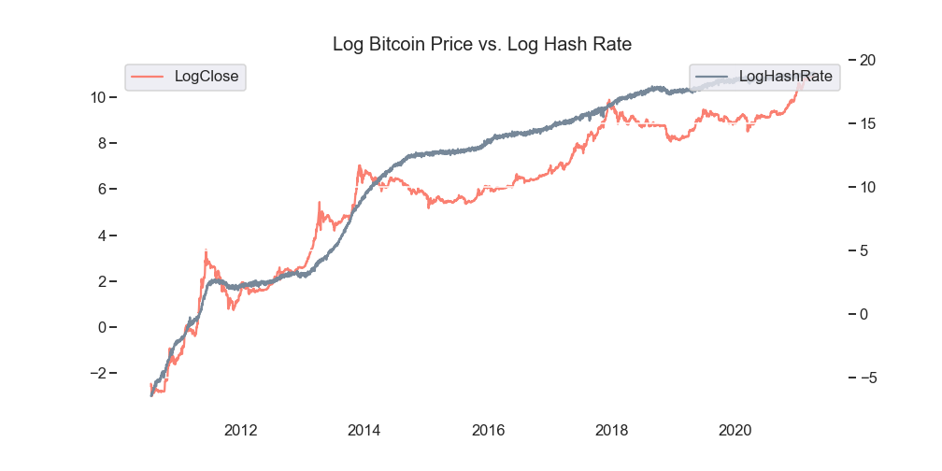

Slide 14
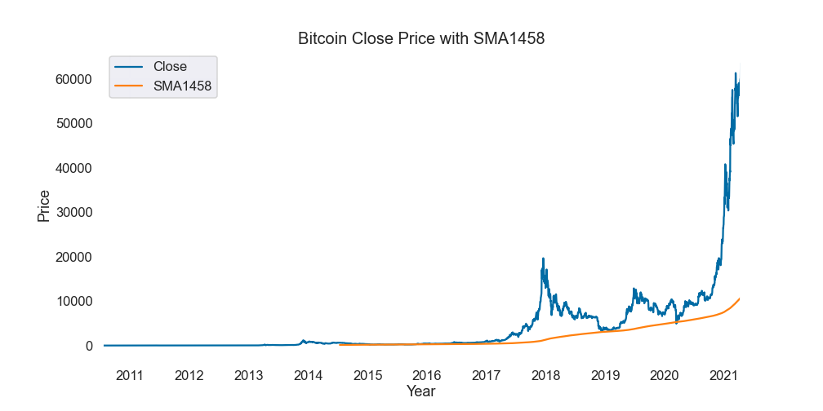

Slide 15
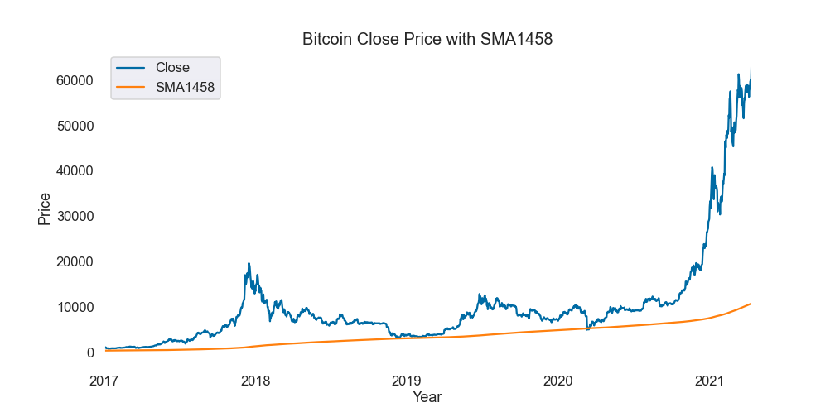

Slide 16
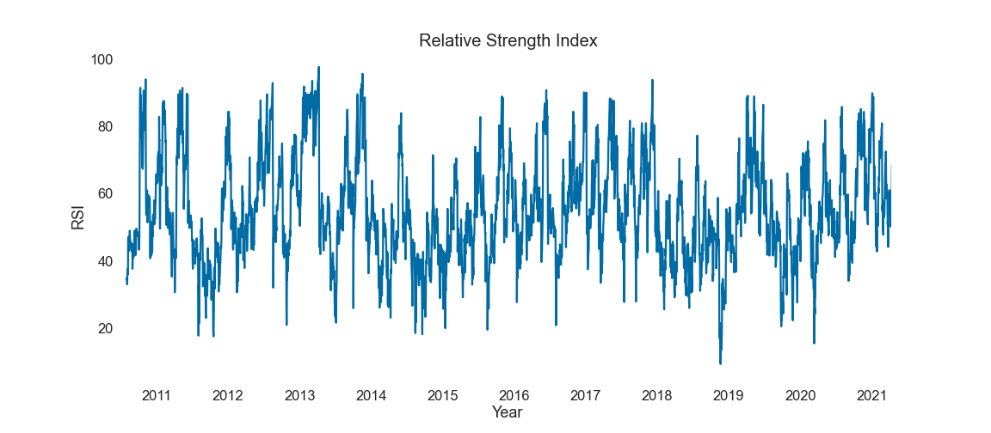

Slide 17
Models
Forecasting
with ARIMA

Slide 18
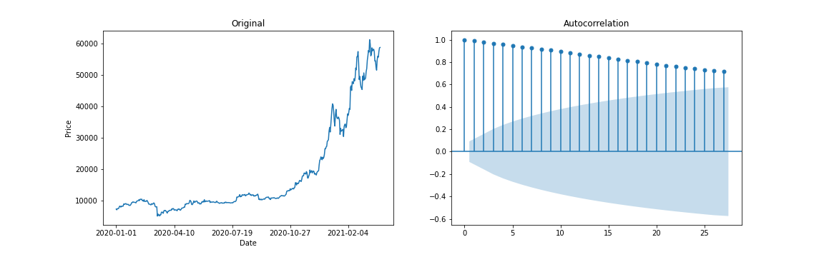
ARIMA

Slide 19
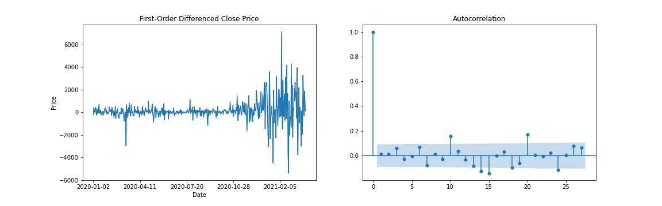
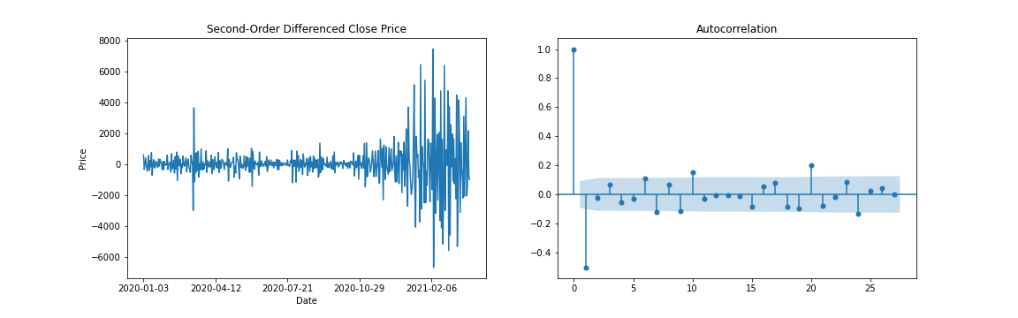
ARIMA
q = 1
p = 10

Slide 20
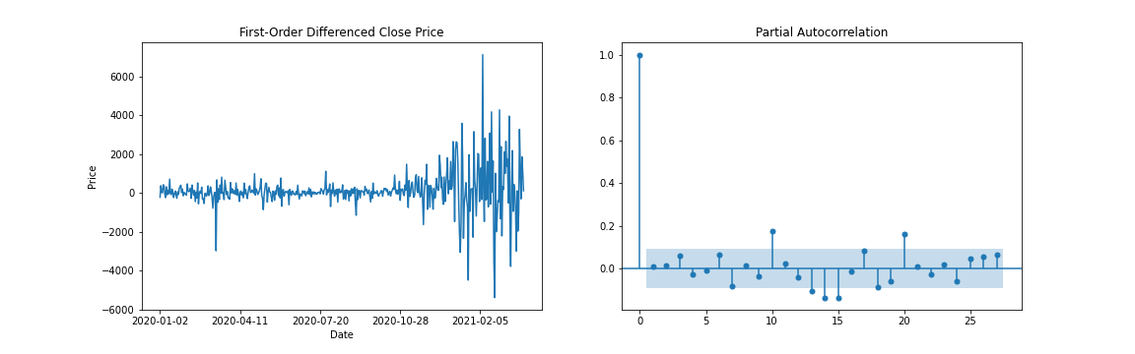
ARIMA
r = 10

Slide 21
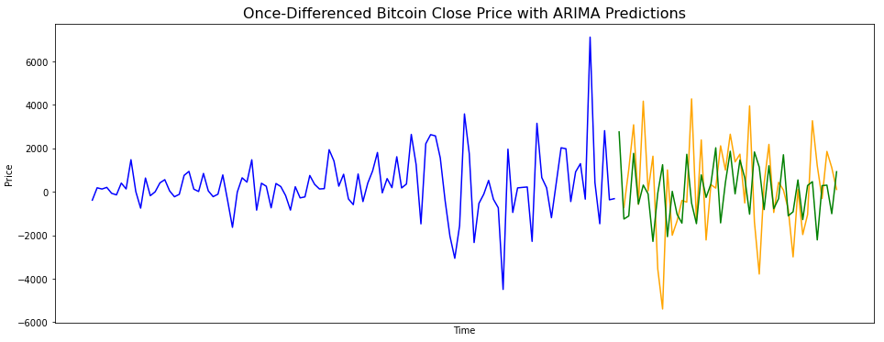
ARIMA

Slide 22
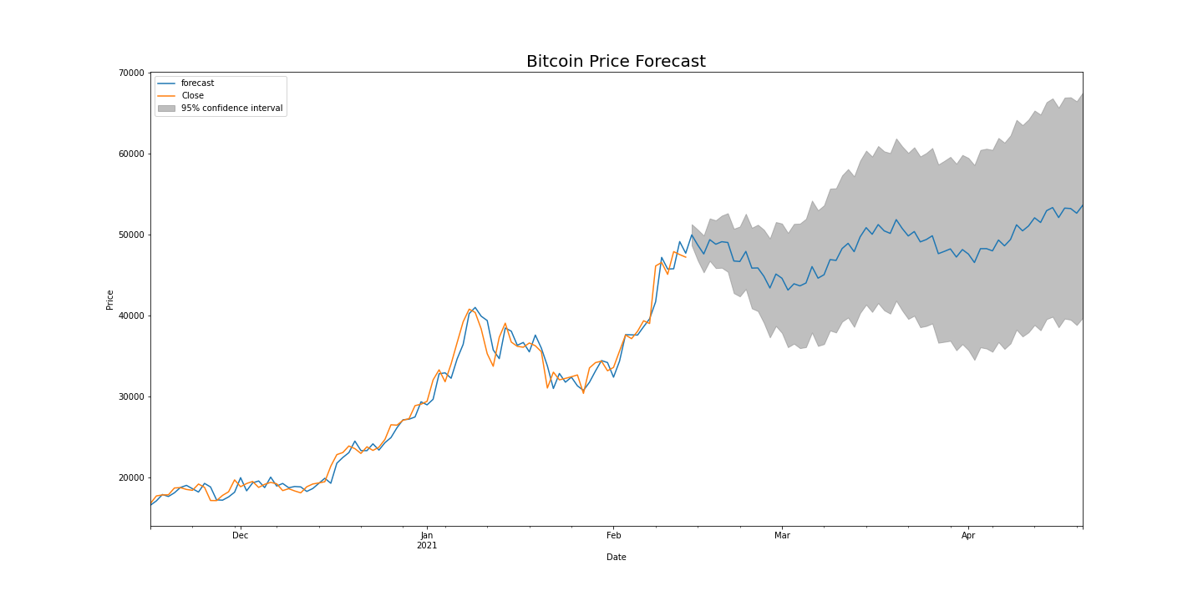
ARIMA

Slide 23
Models
Forecasting
with Prophet

Slide 24
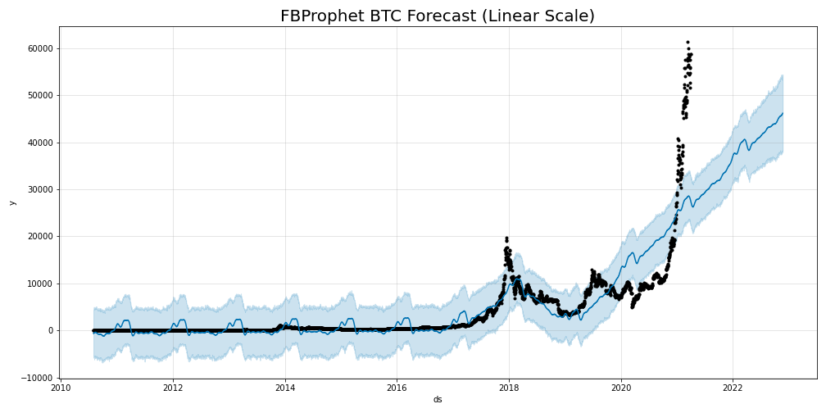
Facebook Prophet

Slide 25
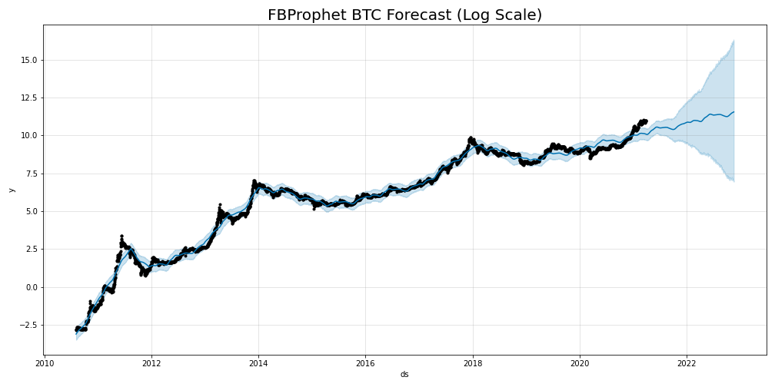
Facebook Prophet

Slide 26
Models
LSTM:
Price Prediction

Slide 27
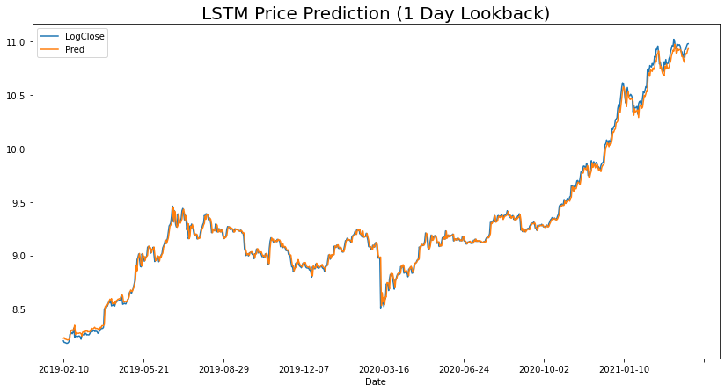
Lookback = 1

Slide 28
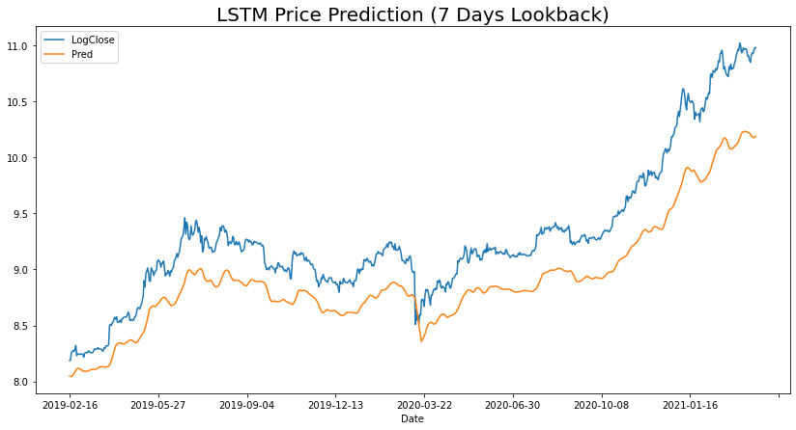
Lookback = 7

Slide 29
Models
RandomForest:
Buy/Sell Signals

Slide 30
Results
Accuracy: 57.7%
Target variable dominance: 58.9%
RandomForest did not beat baseline accuracy

Slide 31
Models
LSTM:
Buy/Sell Signals

Slide 32
Features Selected
Differenced order 1 of logarithmic close price
Logarithm of unique active addresses
Relative Strength Index (RSI)
Google Trends

Slide 33
Parameters
Standard scale
Lookback = 2 weeks
Batchsize = 16
10% test split
Loss = Binary cross-entropy
Optimizer = Adam
Early stopping

Slide 34
Topology
model.add(LSTM(50)
model.add(LeakyReLU(alpha=0.05))
model.add(Dropout(0.3))
model.add(LSTM(7))
model.add(LeakyReLU(alpha=0.05))
model.add(Dense(1, 'sigmoid'))

Slide 35
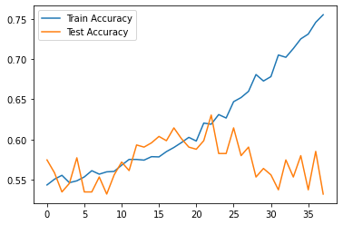
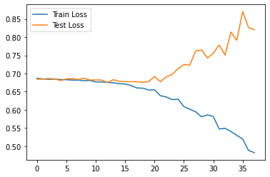
Loss curves
Train set: 53% buys
Model Train: 61% (↑8%) accuracy
Test set: 58% buys
Model Test: 63% (↑5%) accuracy

Slide 36
Accuracy
Returns
Best model: 62.7%
RandomForest: 57.7%
Buy and hold: 58.7%
Buy and hold: 952%
Best model: 886%* If you are a prophet: 35300%

Slide 37
Conclusions
Predicting accuracy is one thing, but you may end up losing larger gains from missed signals
Sometimes less is better

Slide 38
Takeaways
Neural networks kind of a black box
Discern quality from online sources
More time spent tuning != to better results

Slide 39
Thanks

